Slide 1
Finding patterns and predicting future value in patents: A Volkswagen Case Study
James Ng Zhu Yang
For Internal Use Only

Slide 2
Research Questions
If near future values of subclasses can be predicted using statistical and machine learning methods.
Which methods in each are the most suitable in the prediction task.
What key trends or time periods are influencing model outputs.

Slide 3
AGENDA
Methodology Overview
Exploratory Findings
Model Findings
Analysis, Future Work, Conclusions

Slide 4
introduction
This project intends to understand the feasibility of employing statistical and machine learning models to predict future trends of patents using subclass level patent information.

Slide 5
Methodology
Summaric overview of project method

Slide 6
The Information CYcle
Exploratory Data Analysis
Literature Review
Modelling and Coding
Results Analysis
Model parameter tuning

Slide 7
Exploratory FIndings

Slide 8
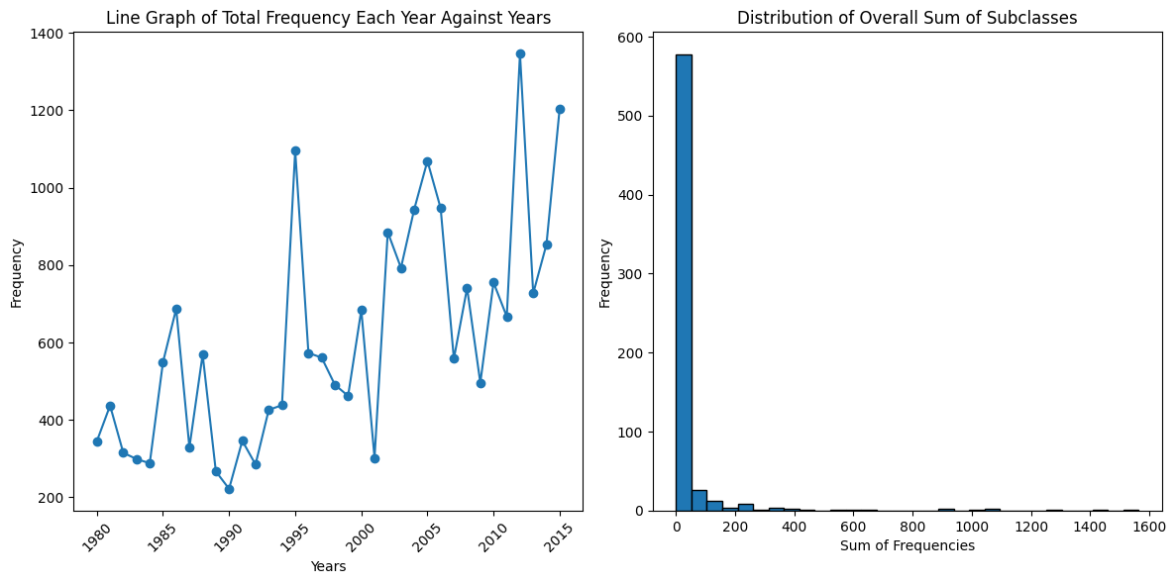
Annual patterns
Key points:
Overall Upward Trend
“Peaks” every 9-10 years. (1986, 1995, 2005, 2012)
Patent research highly concentrated on very few subclasses. Spread out otherwise.

Slide 9
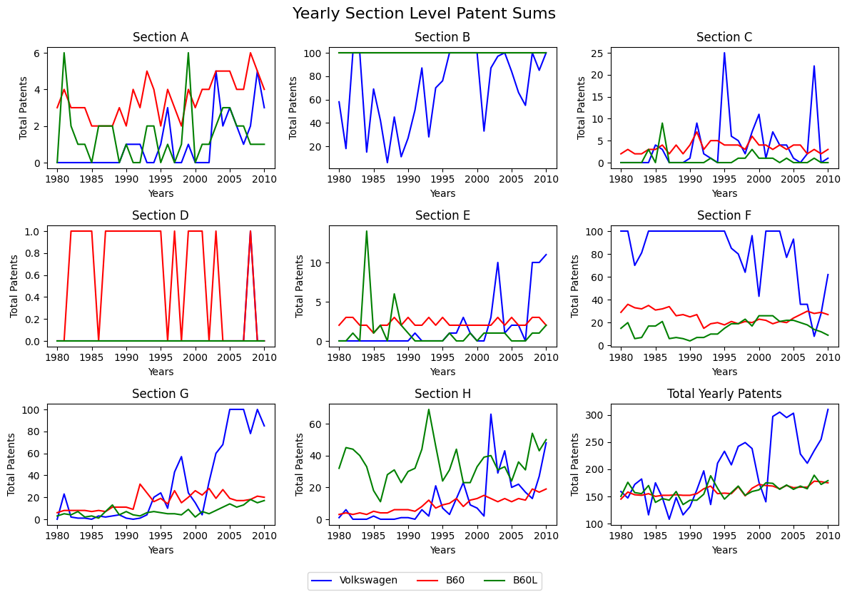
Section level trends

Slide 10
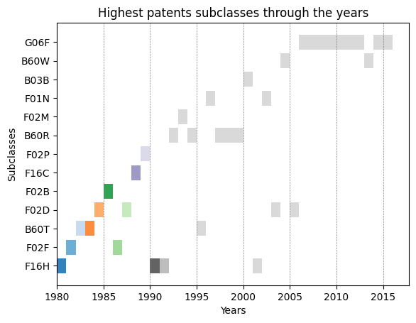
Key subclasses
By Gantt Chart method

Slide 11
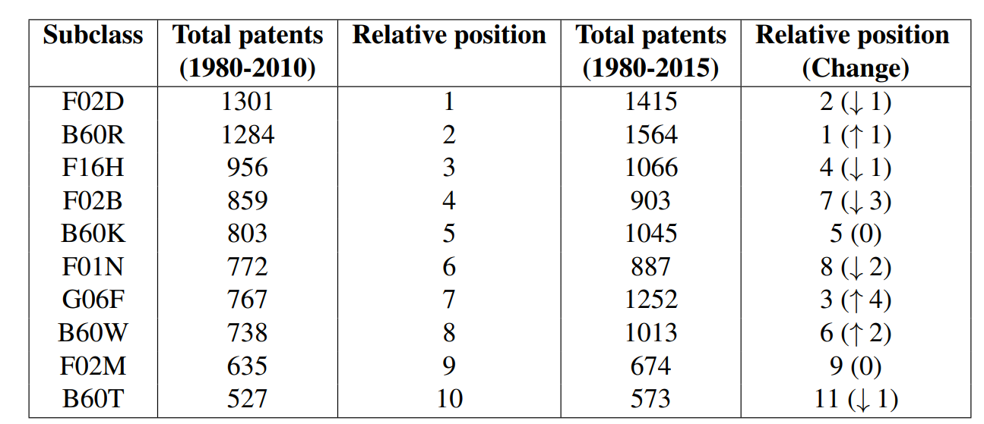
Top 10 through the years

Slide 12
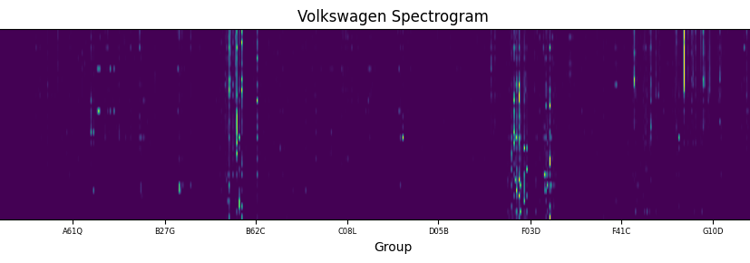

Slide 13
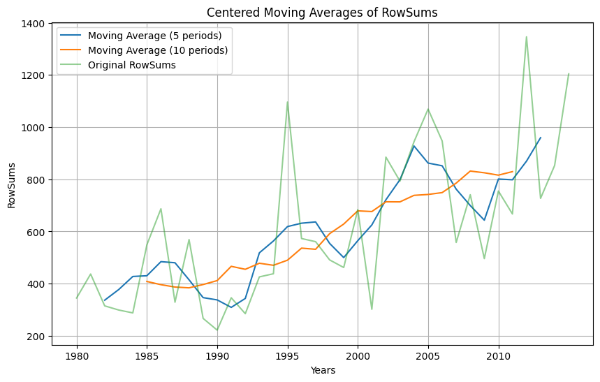
Moving Averages

Slide 14
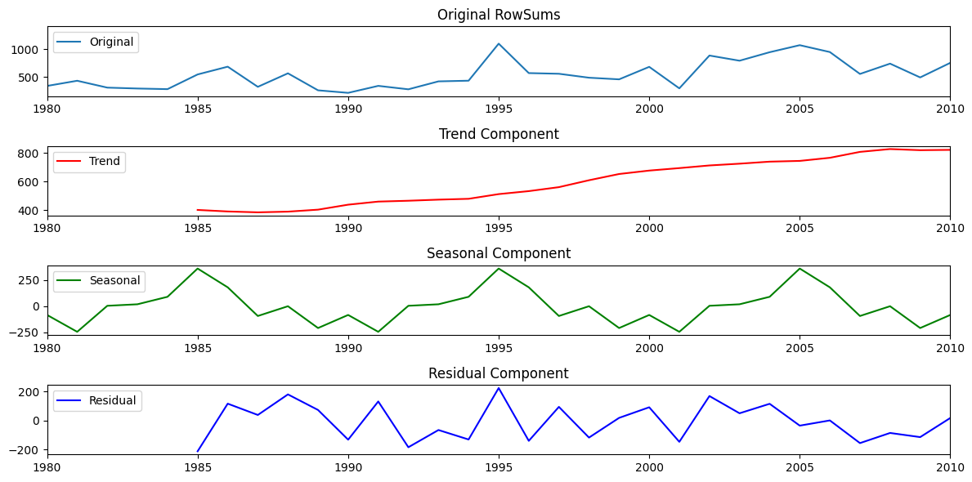
Trend breakdown

Slide 15
MOdel FIndings
Mean Absolute Error is the main evaluation metric

Slide 16
Statistical Models
Two models:
Simple Moving Averages
Exponentlal Moving Averages
Key purpose:
To set a relative benchmark as näive models compared to machine learning models
Additional purpose(s):
To inform earlier findings where appropriate

Slide 17
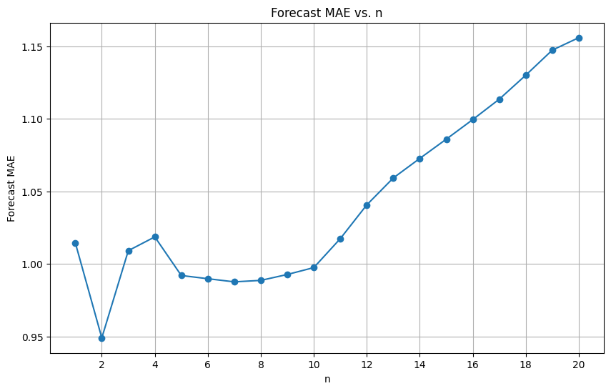
Simple moving averages
Key points:
Higher N, Higher Error
Higher N, Slower convergence
Good minima range between n=5 and n=9 excluding n=2
Trend is lost when converging to the average.

Slide 18
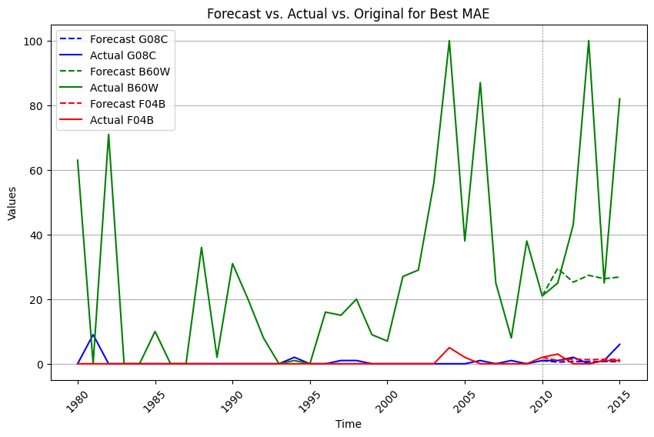

Slide 19
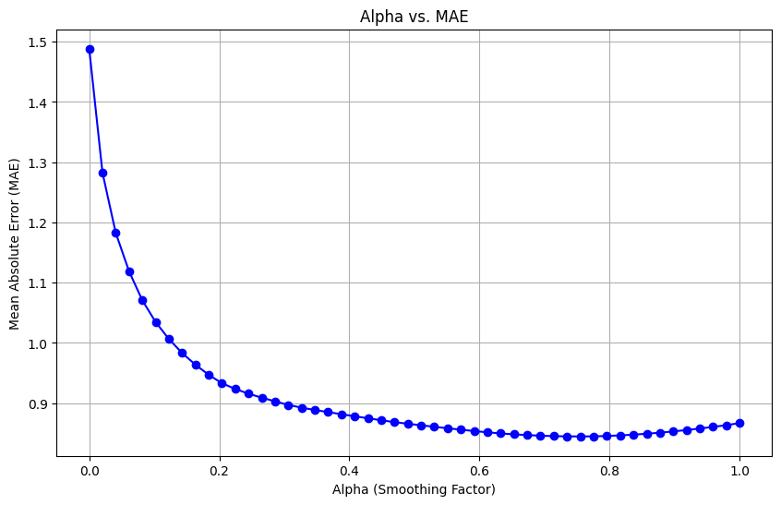
Exponential moving averages
Key points:
Alpha is between 0 and 1
Higher Alpha, More Fitting
Alpha=1 gives original data
Is only useful for one-year outlook
Overfitting is a problem

Slide 20
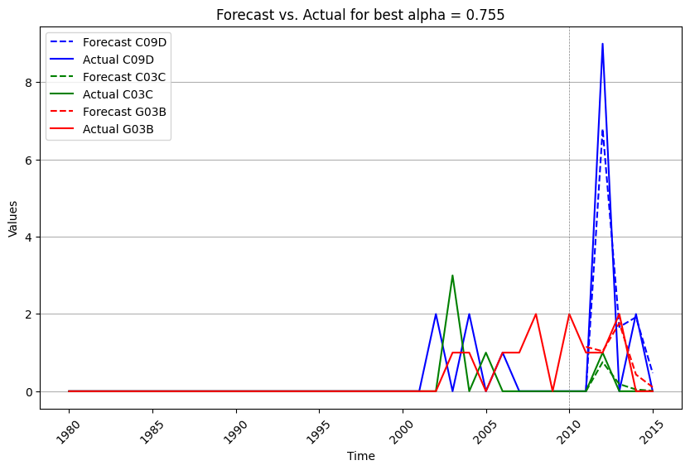

Slide 21
Machine Learning Models
One approach, two parts:
Single-shot 1-year predictions
Single-shot 5-years predictions
Multiple models used. Additional ones used for 5-years predictions.
Key purpose:
To understand how models perform the longer the forecast horizon.
Additional purpose(s):
To inform earlier findings where appropriate

Slide 22
Data preparation
Train/Validation/Test splitting
Removing Zero Columns of training set from all sets
Normalization
Note: G06F, a key subclass in later years, for “Electric Digital Data Processing’, was dropped in this part.

Slide 23
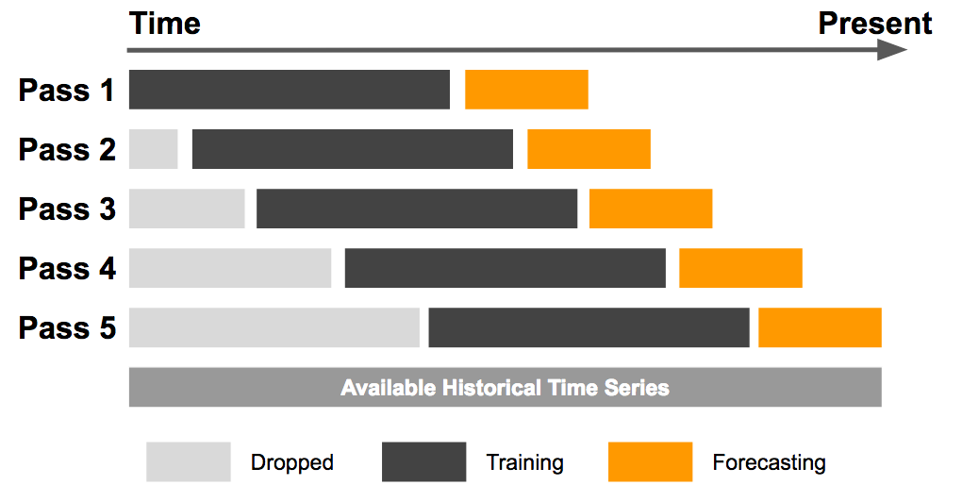
Sliding windows

Slide 24
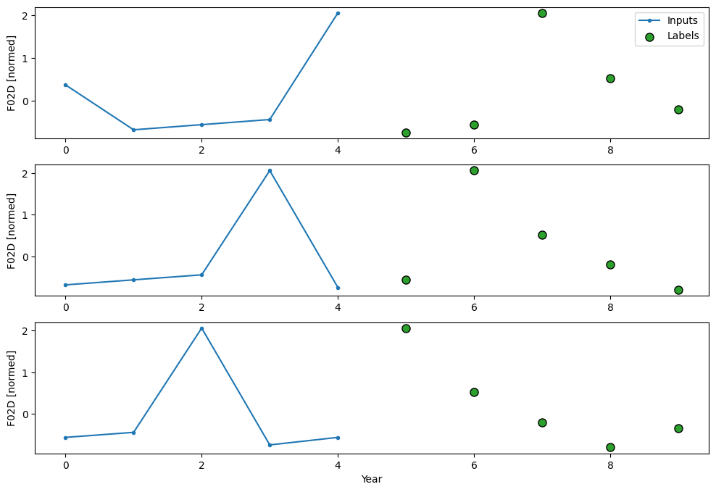
Window Forecast

Slide 25
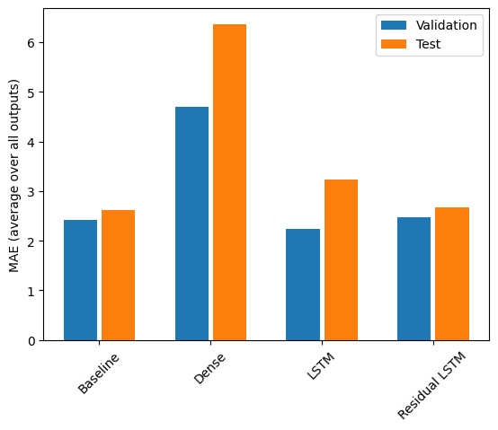
1-Year prediction models
Key points:
Baseline model copies the last input (2010) for the next value (2011)
All models underperform compared to this.

Slide 26
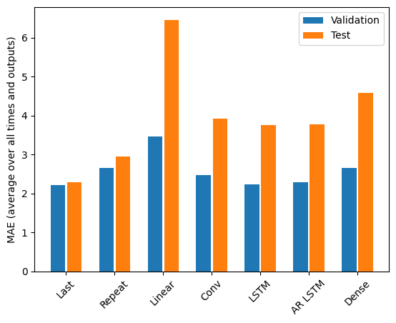
5-Years prediction models
Key points:
Baseline model copies the last input (2010) for the next values (2011-2015)
Repeat baseline copies the last input of desired length (2006-2010) For the next values (2011-2015)
All models underperform compared to this on the test horizon (2011-2015)

Slide 27
Analysis, Future Work, Conclusions

Slide 28
Technical ANalysis
Data Split Ratio
Number of Subclasses
Relatively short time frame overall (36 years of data)
Model architecture resulted in a necessarily poor split of data into training, validation, and testing sets.
Only 105 subclasses remaining in training.
Important subclasses in latter years dropped, such as G06F.
Relationship between subclasses lost in training when dropped.

Slide 29
Qualitative ANalysis
Failure to capture trends
Overgranularity/Lack Of Additional Information
Models unable to appropriately identify tech trend changes in later years. (i.e. F16H, F02F, to B60W, G06F)
105 feature points (subclasses) still significant given time horizon of 36 (years).
Need to provide clustering or capture relationship between frequencies by patent identifiers.
Need of prior art citation information to track trajectories of clusters.

Slide 30
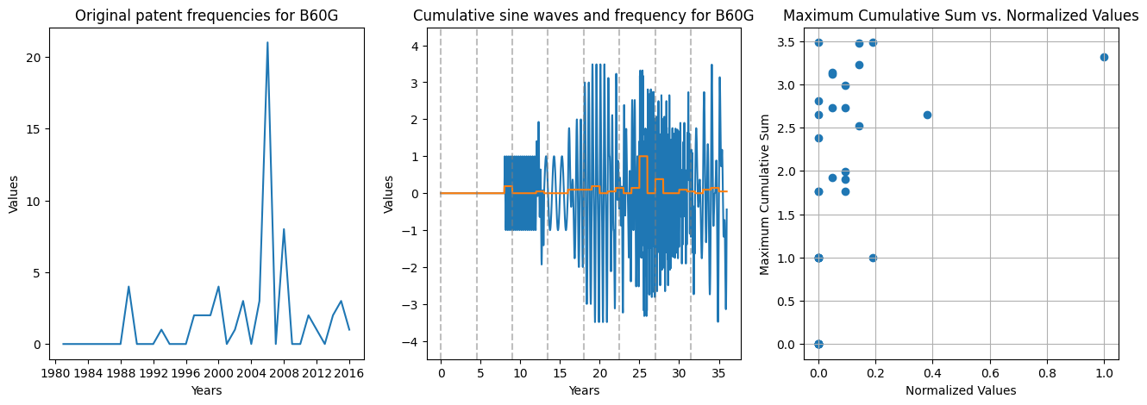
Future work
Audio analysis attempt

Slide 31

Conclusion
Outcomes:
Yes. However, subclass frequencies data alone is clearly insufficient.
Näive models are better for 5-years predictions, while LSTM is the best ML model for 5-years predictions.
2010-2015 represents a big shift to digital technologies for Volkswagen. These are not represented sufficiently, if at all, earlier.

Slide 32
Q&A

Slide 33
THANK YOU
Presenter name
Email address
Website

